Slide 1
Introduction to CSS
PROG8540
Web Foundations

Slide 2
Topics
CSS – Cascading Style Sheets
Adding CSS to HTML
Three Methods of CSS
CSS Comments, White Space and Indentation
Defining Size and Colour with CSS
CSS Rulesets: Properties and Values
Define Fonts with CSS/ Google Fonts
CSS Box Model

Slide 3
CSS – Cascading Style Sheets ^{[1]}
CSS is a style sheet language that is used to provide style to web pages.
CSS rulesets style the HTML elements as defined by the declarations written in the rulesets.
A CSS ruleset (normally called just rule) targets an HTML element using a selector and defines its appearance.
p{
color: red;
}

Slide 4
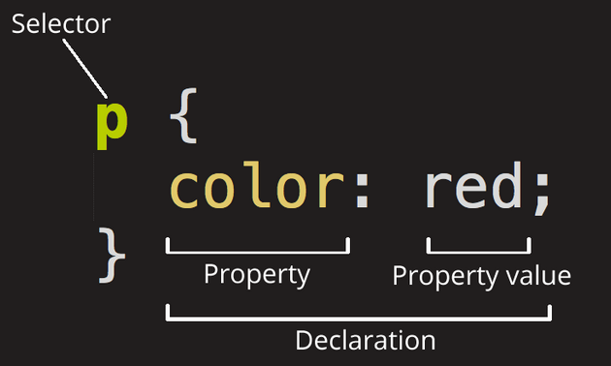
CSS Rule
CSS rule
  Selector
  Declaration(s)
Figure 1. Anatomy of a CSS ruleset showing a CSS declaration.
Note. From Mozilla Contributors, 2021. CC BY-SA 2.5

Slide 5
Adding CSS to HTML
Browser Defaults^{[2]}
  Here is a very good video that explains browser defaults in detail: https://youtu.be/spK_S0HfzFw
Reset Browser Defaults
  Here are the links to two CSS resets that you can use (as mentioned in the video):
    Eric Meyer’s CSS Tools: Reset CSS
    Normalize CSS

Slide 6
Three types of CSS ^{[3]}
Inline
Internal
External

Slide 7
Three types of CSS ^{[3]}
Inline CSS- style attribute
<!DOCTYPE html>
<html>
<head>
<meta charset="utf-8">
<title>Inline CSS</title>
</head>
<body>
<p style="color:red;">This will appear in red.</p>
<p>This will not appear in red.</p>
</body>
</html>

Slide 8
Three types of CSS ^{[3]}
Internal CSS- style tag within head section
<html>
<head>
<meta charset="utf-8">
<title>Internal CSS</title>
<style>
p {
color: red;
}
</style>
</head>
<body>
<p>This is a paragraph. </p>
<p>This is another paragraph. </p>
</body>
</html>

Slide 9
Three types of CSS ^{[3]}
External CSS- external file/ sheet (.css)
<!DOCTYPE html>
<html>
<head>
<meta charset="utf-8">
<title>External CSS</title>
<link rel="stylesheet" href="path_to_file/style.css">
</head>
<body>
<p>This is a paragraph. </p>
<p>This is another paragraph. </p>
</body>
</html>
p{
color: red;
}
CSS file: style.css
HTML file: index.html

Slide 10
Comments, White Space and Indentation ^{[3]}
Just like HTML, we can write comments in CSS too and also use white space for indentation.
Comments
White Space and Indentation
/* This is a CSS comment */
p{
color: red;
font-family: Arial, sans-serif;
font-weight: bold;
}

Slide 11
Defining Size and Colour with CSS
  Defining Size (in Units)
  Relative Units (em, rem) adapt to the size of other elements and are great for responsiveness (flexible, responsive, allow for better scaling)
  Absolute Units (px) fixed and ensure a specific size, suitable for precise layouts (good to start with, simple to use, precise)
  Viewport Units (vw, vh) respond to the size of the viewport, enabling fluid designs that scale with the window size. (responsive, adjust based on screen size)
  * conversion: 1 em= 16 px=16 px

Slide 12
Defining Size and Colour with CSS
Define Colour: There are seven ways to define colours in CSS
  6-digit hex colour #RRGGBB
  3-digit hex colour #RGB
  named colours red, blue, green
  rgb method rgb(red, green, blue)
  rgba method rgba(red, green, blue, alpha)
  hsl method hsl(hue, saturation, lightness)
  hsla method hsla(hue, saturation, lightness, alpha)
The following video explains a few different ways to define colours in CSS. https://www.youtube.com/watch?v=LYDQ_L7ovyg
Notes:
1- Uses six characters (two for red, green, and blue) in hexadecimal (0-9 and A-F). Each pair represents the intensity of that color.
2- A shorthand version of the 6-digit hex code. Each character is duplicated (e.g., #F53 is the same as #FF5533).
3- CSS has a set of predefined color names you can use directly. Easy to remember but limited in variety.
4- Defines colors using three numbers representing the intensity of red, green, and blue (0-255).
5- Similar to RGB, but adds an alpha value for transparency (0 is fully transparent, 1 is fully opaque).
6- Defines color using hue (0-360 degrees on a color wheel), saturation (0% to 100%), and lightness (0% to 100%).
7- Similar to HSL, but includes an alpha value for transparency.
Hue refers to the color itself and is one of the main attributes of color in the HSL (Hue, Saturation, Lightness) and HSV (Hue, Saturation, Value) color models. It describes the type of color you see and is represented as an angle on a color wheel.
Color Wheel:
The hue is measured in degrees, from 0° to 360°.
For example:
0° (or 360°) = Red
120° = Green
240° = Blue
60° = Yellow
2. Visual Representation:
On a color wheel, different positions correspond to different colors.
As you move around the wheel, you transition through the spectrum of colors.

Slide 13
Defining Size and Colour with CSS
CSS gradients let you display smooth transitions between two or more specified colors.
CSS Gradients (w3schools.com)

Slide 14
CSS Rulesets: Properties and Values^{[1][2]}
CSS ruleset:
  Selectors
  Declarations
CSS declaration:
  Property
  Value
  For example, to change a property ‘color’ of a paragraph so that it appears in ‘red’ (value) colour, the declaration is written as:
p{
color: red;
}
color: red;

Slide 15
Example: Writing a CSS ruleset
In this example, there are 2 declarations:
color: red;
font-weight: bold;
p{
color: red;
font-weight: bold;
}

Slide 16
Learning Some CSS Properties ^{[4]}
B
border
box-shadow
C
color
F
font-family
font-size
font-style
font-weight
H
height
L
line-height
M
margin
margin-bottom
margin-left
margin-right
margin-top
P
padding
padding-bottom
padding-left
padding-right
padding-top
T
text-align
W
width

Slide 17
Define Fonts with CSS
CSS is an effective way to create consistency of fonts across your website.
The following video shows how to use font-family, font-weight, font-size, font-style, line-height, font-variant and font shorthand.
https://www.youtube.com/watch?v=na2BRPRQQQQ
You can import a variety of Google fonts from here: Browse Fonts - Google Fonts

Slide 18
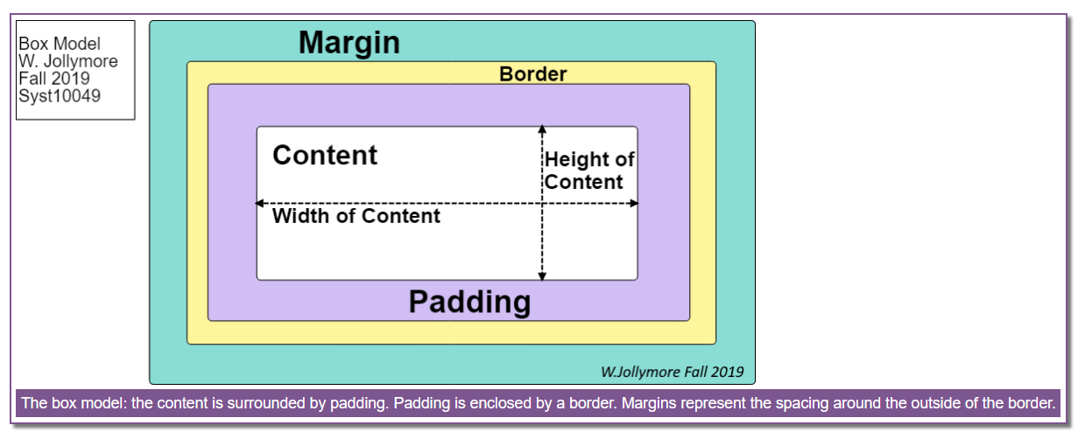
CSS Box Model

Slide 19
Summary
CSS and various types of CSS
Connect CSS to your web pages
Browser defaults
CSS properties and values, measuring units, colours, comments and indentation using white space
Different fonts to change the appearance of the text
CSS box model properties allow you to set space within and around an element

Slide 20
Let’s Practise!

Slide 21
References
1. Adapted from Mozilla Contributors. (2021). CSS basics. Retrieved 2021, January 07.
https://developer.mozilla.org/en-US/docs/Learn/Getting_started_with_the_web/CSS_basics
Licensed under CC BY-SA 2.5
2. Adapted from Mozilla Contributors. (2021). What is CSS?. Retrieved 2021, January 07.
https://developer.mozilla.org/en-US/docs/Learn/CSS/First_steps/What_is_CSS
Licensed under CC BY-SA 2.5
3. Adapted from Mozilla Contributors. (2021). How CSS is structured. Retrieved 2021, January 07.
https://developer.mozilla.org/en-US/docs/Learn/CSS/First_steps/How_CSS_is_structured
Licensed under CC BY-SA 2.5
4. Adapted from Mozilla Contributors. (2020). CSS Reference. Retrieved 2021, January 08.
https://developer.mozilla.org/en-US/docs/Web/CSS/Reference
Licensed under CC BY-SA 2.5

Slide 22
References
Griffith, S. (2018, June 27). CSS Color Property Values [Video]. YouTube. https://www.youtube.com/watch?v=LYDQ_L7ovyg
Andrew, R. (2015, December 21). The CSS Layout Workshop: Relative units [Video]. YouTube. https://www.youtube.com/watch?v=tSoHeAtGMk8
Andrew, R. (2015, December 21). The CSS Layout Workshop: Absolute units [Video]. YouTube. https://www.youtube.com/watch?v=_YnVRj2z-YM
Andrew, R. (2015, December 21). The CSS Layout Workshop: Viewport units [Video]. YouTube. https://www.youtube.com/watch?v=_YnVRj2z-YM
Griffith, S. (2018, July 04). CSS font and font-family Properties [Video]. YouTube. https://www.youtube.com/watch?v=na2BRPRQQQQ
Copyright Notice
The content on this document that is adapted from Mozilla Contributors is available under the terms of the Creative Commons Attribution-ShareAlike license (CC-BY-SA), v2.5 or any later version.

Slide 23
Thank you!
Any questions?

