Slide 1
Sectioning& Grouping Content
PROG8540
Web Foundations

Slide 2
Agenda
Semantic vs. Non-Semantic Elements
Sectioning& Grouping Content
Basic sections of a website
Plan a simple website
Analyze different websites on the internet – Activity
Demo& Publishing

Slide 3
Semantic vs. Non-Semantic Elements
When HTML5 was released in 2014, it included a set of new semantic elements, which add more meaning to a web document.
  Semantic elements are HTML elements whose element or tag name clearly defines what kind of content the element contains
  Non-semantic elements have names that don't clearly identify their contents.

Slide 4
Semantic Elements
It's important to use semantic elements where appropriate, because it can optimize search engine searches for the page's content
They're more accessible to screen readers, and it makes it much easier for other developers or yourself to understand the page content and structure and find specific blocks of code for editing.

Slide 5

Semantic Elements
Semantic elements are accessible according to the WCAG and WAI-ARIA guidelines.
It's important to always use the appropriate semantic element that is most appropriate and not use generic elements that have no meaning (unless the meaning isn't important).
You should never use a semantic element for any purpose other than the one it's intended for
Accessibility

Slide 6
Examples of Semantic Elements
Here are a few of the common semantic elements
  <header> - the document header, but can also be used for an article/section header
  <footer> - the document footer, but can also be used for an article/section footer
  <article> - to contain an article (news, blog, tutorial, etc.

Slide 7
Non-Semantic Elements
We still use non-semantic elements for some parts of a page or application.
It's important that you don't use semantic elements for any purpose other than the purpose for which they were intended.

Slide 8
Examples of Non-Semantic Elements
<p> element is a general paragraph: it's not a paragraph of a blog post, article, sidebar, etc.
<div> element is a block element that can contain any text, and it's often used as a container for other elements.
We still use <div> and <span> elements to contain content that we want to style a certain way or that doesn't really fit with any of the semantic elements.
It’s bad to use a <section> element for a document footer or a <footer> element for anything that's NOT a document footer.

Slide 9
Example
Can you guess what these elements are for, just by the element name:
  <form>
  <table>
  <figure>, <figcaption>
  <input>
  <button>
  <details>
  <nav>
  <summary>
  <time>
  <menu>
  <abbr>
  <audio>, <video>
  <picture>, <img>
  <address>

Slide 10
Sectioning Content
Semantic containers:
  <header>
  <article>
  <main>
  <section>
  <nav>
  <footer>
  <aside>

Slide 11
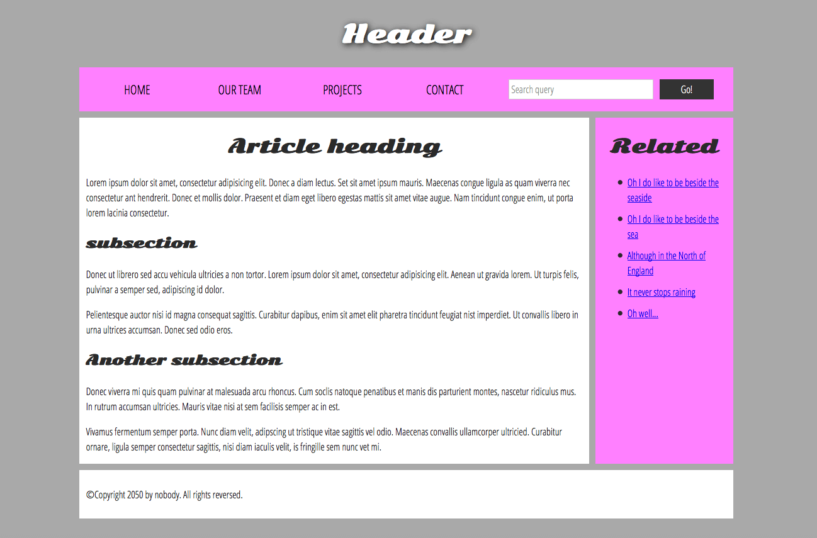
Basic Sections
Figure 1. A typical website from MDN Web Docs, 2020. Licensed under CC BY-SA 2.5

Slide 12
Plan a simple website
Decide the common elements
Draw a rough sketch of each page
Brainstorm the other content of individual pages
Create a rough sitemap

Slide 13
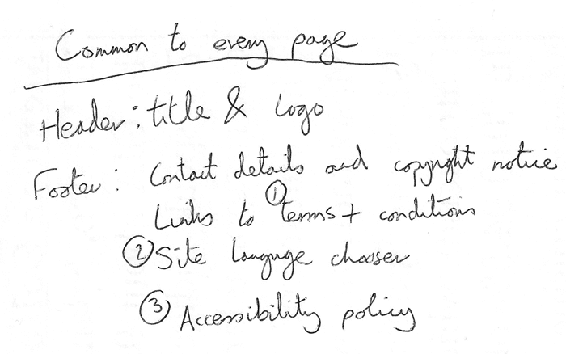
Plan – Common Elements
Note down the common elements that will repeat on all the pages
Some of the common elements are:
  Header – Title and logo
  Navigation bar
  Footer elements
  Copyright notices
Figure 2. Common features from MDN Web Docs, 2020. Licensed under CC BY-SA 2.5

Slide 14
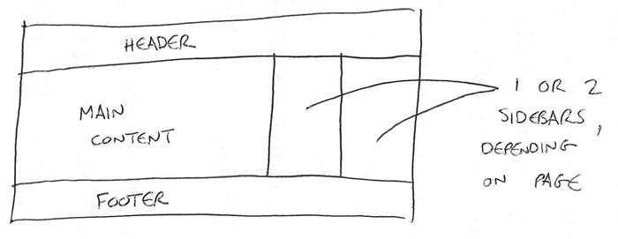
Plan – Rough sketches
Draw a rough sketch of each page.
This gives you an idea of what each page should look like.
Figure 3. Rough sketch from MDN Web Docs, 2020. Licensed under CC BY-SA 2.5

Slide 15
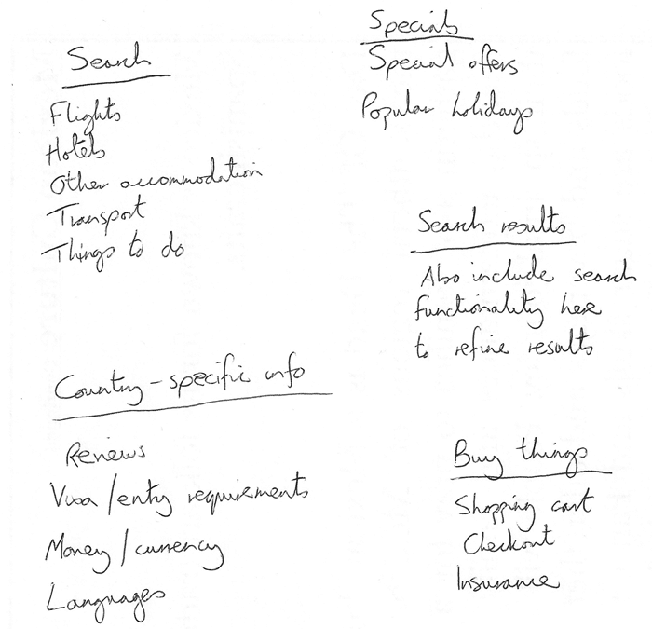
Plan – Brainstorm the other content
Brainstorm what content is unique to each page.
Sort the content of each page under different headings.
Figure 4. Card Sorting from MDN Web Docs, 2020. Licensed under CC BY-SA 2.5

Slide 16
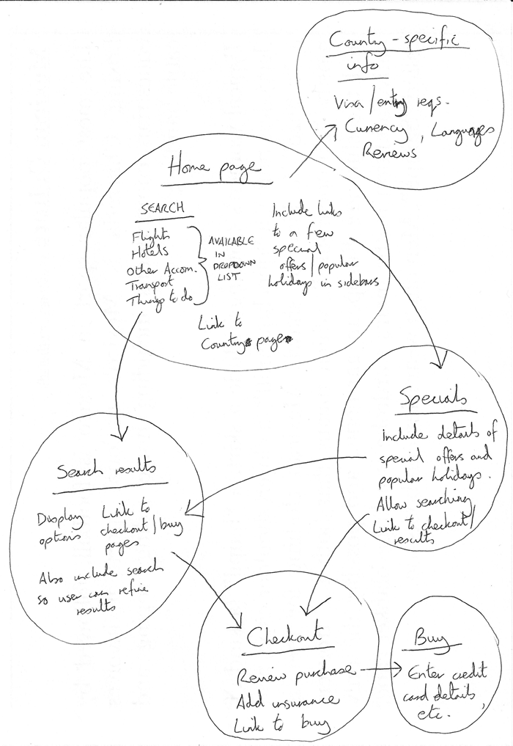
Plan – Sitemap
Draw a rough sitemap of your site.
This tells you what pages will go in your navigation and how pages link to each other.
You can also use tools like Mindmup for this:
https://app.mindmup.com/map/new/
Figure 5. Sitemap from MDN Web Docs, 2020. Licensed under CC BY-SA 2.5

Slide 17
Analyze different websites - Activity
Find out what the following terms mean and look for these items on the list of the websites on the next page:
Design consistency across pages
Common elements on different pages
Usability
Search Engine Optimization
Responsive design
Cross browser compatibility
AODA standards
Post your findings on the related discussion forum in eConestoga.

Slide 18
Analyze different websites - Activity
https://www.conestogac.on.ca/
https://www.amazon.ca/
https://developer.mozilla.org/en-US/
https://nodejs.org/en/
https://stackoverflow.com/
http://www2.pnwx.com/

Slide 19
References
MDN Web Docs. Document and website structure. Retrieved September 13, 2020 from https://developer.mozilla.org/en-US/docs/Learn/HTML/Introduction_to_HTML/Document_and_website_structure

Slide 20
Thank you!
Any questions?

